Slide 1
Year 8 Family Information Evening
Welcome - Mrs. Clinton - Headteacher

Slide 2
Working together to support your child.
Key dates / events for Year 8.
Living with a teenager……
Attendance
Contacts
Governor update

Slide 3
1. Working together to support your child.
Organise, organise, organise! NEVER ASSUME!!
Check their timetable at the weekend and every night, to prepare PE kit, practical resources
Check the homework on Satchel One and encourage them to respect the deadlines.
Look at your child’s work and encourage them to check it through
for spelling errors, punctuation, neatness – this is invaluable.
Don't do the homework for them.
e. Read with them – ask direct questions about their learning.

Slide 4
2. Key dates / events for Year 8.
Year 8 is the year in which we really aim to get children fully involved in the extra-curricular aspect of school life.
Barnwood Park’s Got Talent – auditions taking place now
Dance and PE house competitions each term.
Christmas concert
31st October – Chelsea’s Story
Summer Term – Yr. 8 day trip

Slide 5
3. Living with a teenager……

Slide 6
3. Living with a teenager……
When they are working, pop in from time-to-time + cup of tea + snack and PRAISE them!
b. Find an activity to share with your child (walking the dog, favourite guilty
pleasure, eg. British Bake Off)
c. Expect grunts and one-word answers
d. Don’t touch their hair!
e. Be firm about mobile phone – they do not need their phone to go to sleep. Remove
it from the bedroom.
f. Computer games – need to finish by 7.30pm. Remove the console.
Agree a set bedtime – 8.30pm – 9pm is late enough for a Year 8 student.
REMEMBER THAT THEY ARE STILL CHILDREN…….

Slide 7
Attending well – the best attendance you can possibly have.
A student with 80% attendance (1 day off per week) will miss 1 whole year of school – you will not achieve your potential.

Slide 8
4. Does my attendance matter?
% Attendance | Judgement | Days absent | Impact on your progress
100% | Excellent | 0 days | You are in an excellent position to thrive and achieve well
98% | Very good | 4 days | You are in a strong position to thrive and achieve well
96% | Acceptable | 9 days | You are in a good position to thrive and achieve well but may have missed subject content.
90%-95% | Low attendance and a cause for concern | 14-18 days | You are not in a good position to thrive and achieve well. Relationships could be affected. There will be a significant lack of subject content that will amount to at least one grade lower at GCSE. Your parents/carers may be issued with a Penalty Notice.
90% and below | Extreme cause for concern | 19 days or more | You will struggle to thrive and achieve well. You will find it very difficult to catch up on missed work and are likely to achieve at least 2 grades lower at GCSE. Your parents / carers may be issued with a Penalty Notice.

Slide 9
5. Who to contact?
1. Subject matter? Contact the class teacher.
2. Pastoral matter? Contact the pastoral leader: Ms. Sally Owen

Slide 10
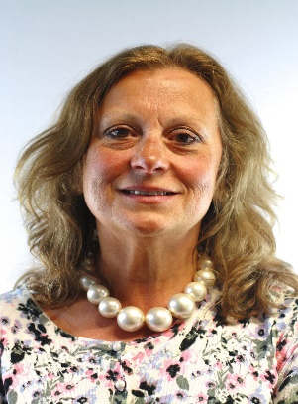
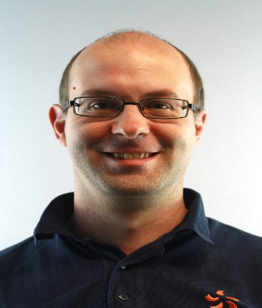
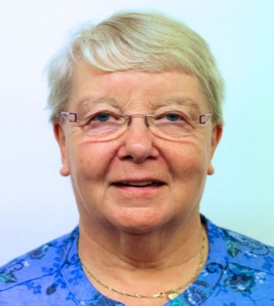
Chair of Governors
Mary Higgins
Vice Chair of Governors
Steven Whitehorn
Safeguarding Governor
Sheila Newman
Community | Performance | Finance
Sheila Newman | Steven Whitehorn | Bob Whittard
Craig Bloxsome | Claire Weaving | Dale Wicks
Debbie Griffin | Amy Fitzgerald-Johnson | Karen Clinton
Stephen Tuffin | Mary Higgins | Jon Haviland
David Lord
Nic Young (Staff) | Stephen Fuller (Staff) | Dani Lee (Staff)
Bryan Gardner (Staff) | Kathryn Rayfield (Staff)

Slide 11
Thank You!

