Slide 1

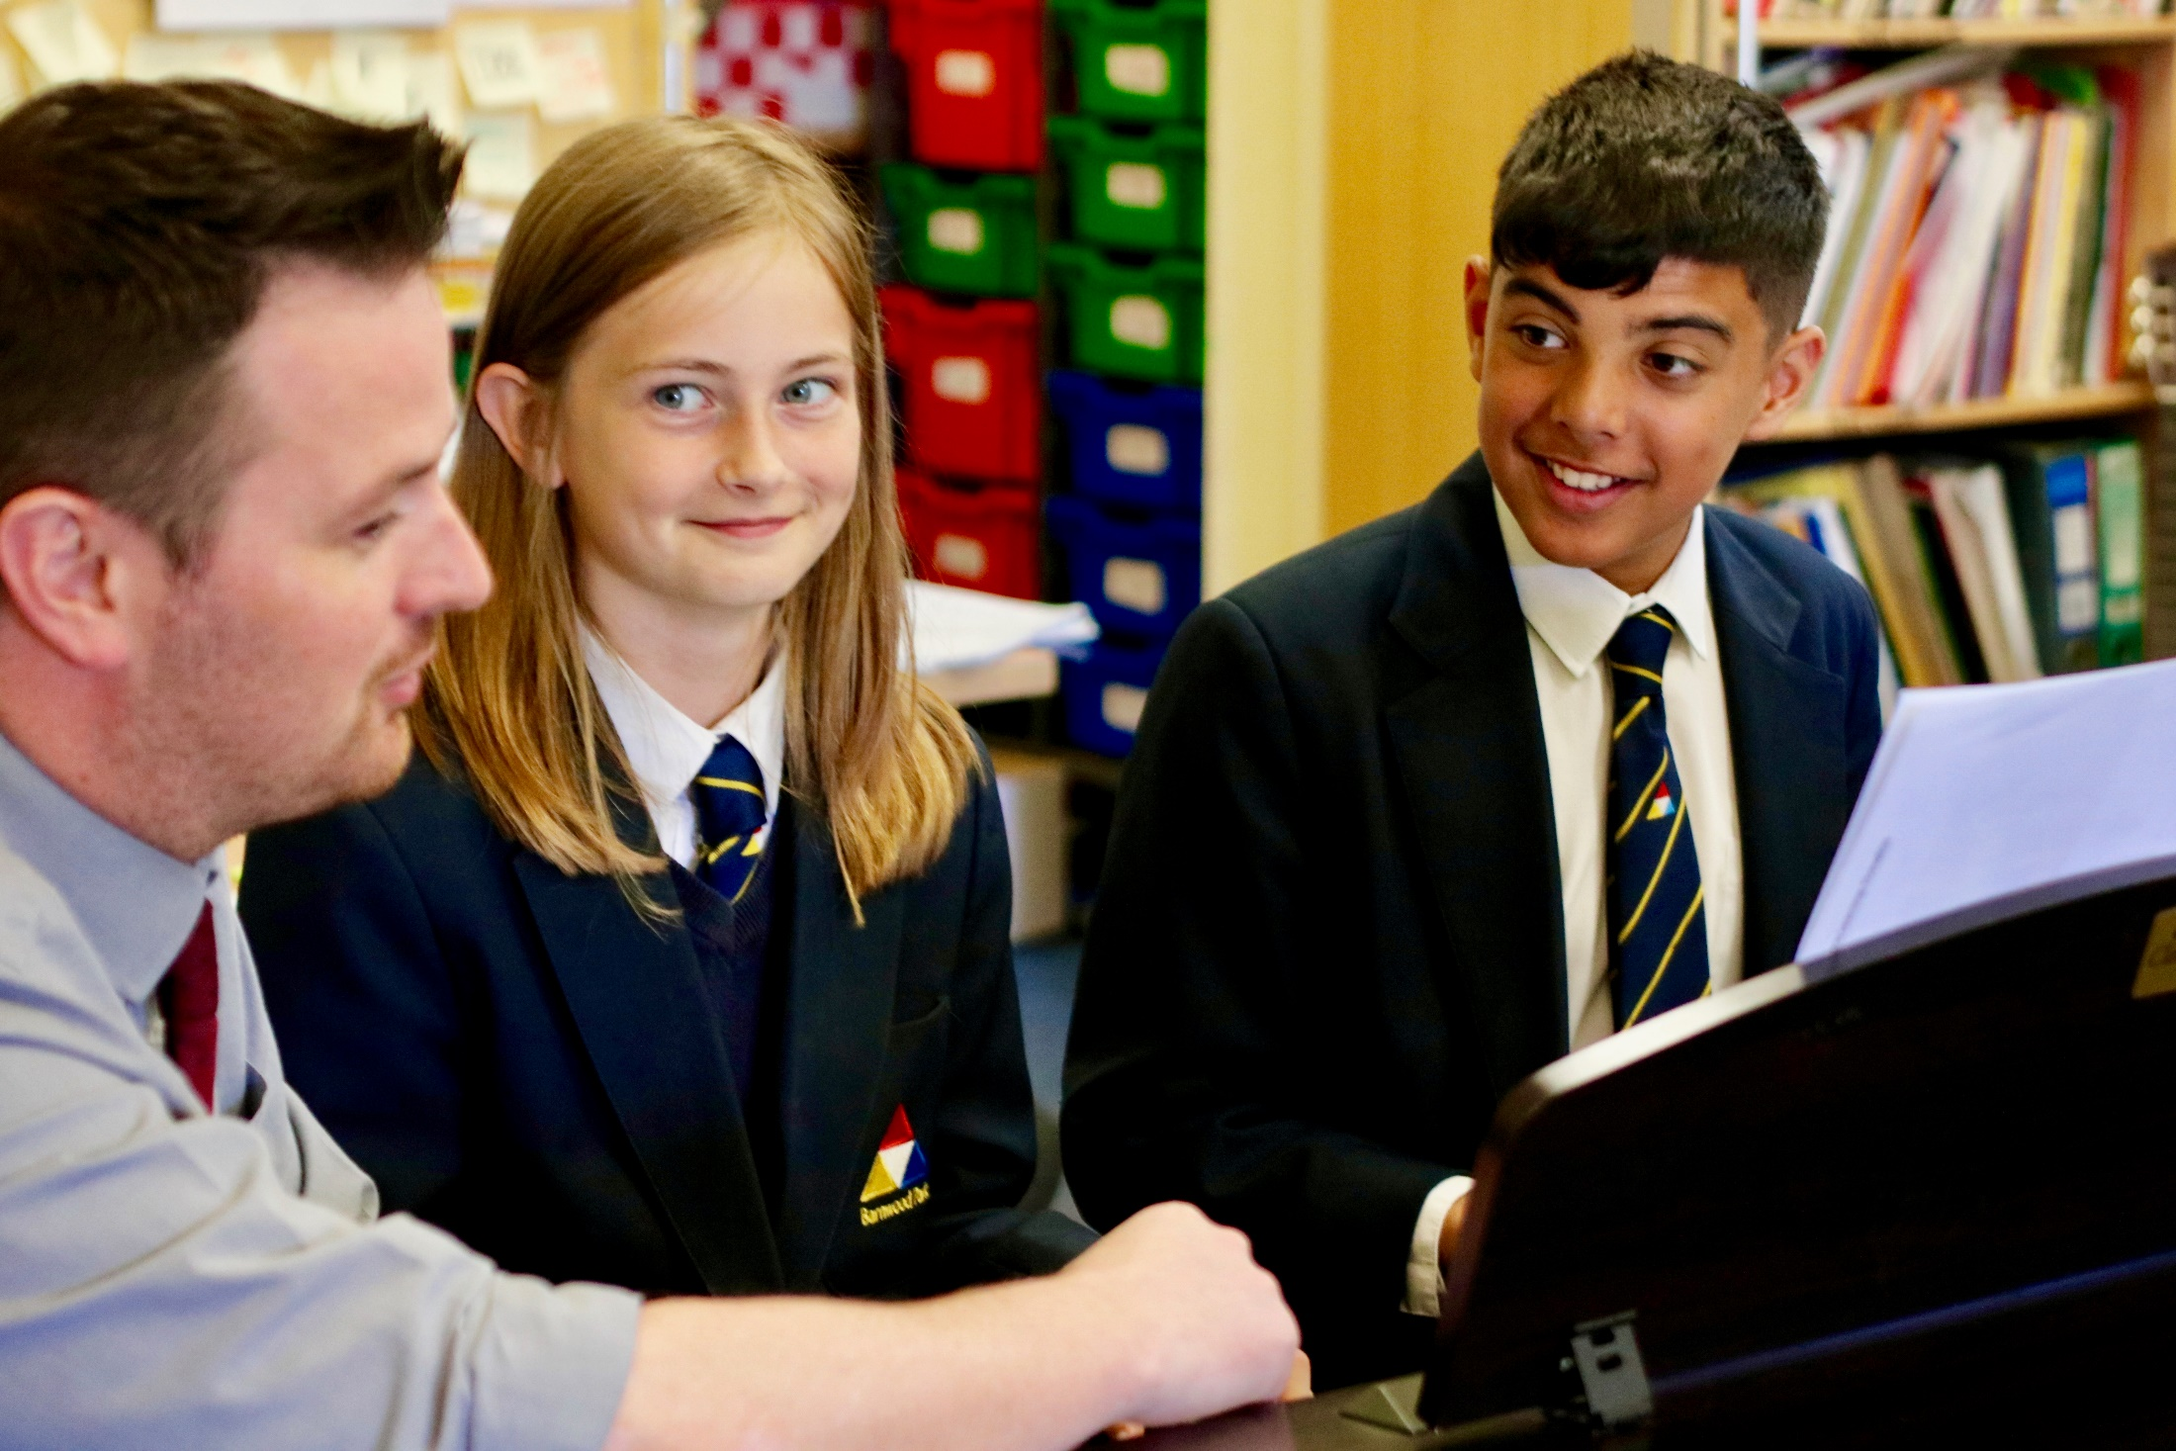
Year 10 Family Information Evening
Welcome - Mrs. Clinton - Headteacher

Slide 2

Working together to support your child.
Key dates / events for Year 10
Living with a teenager……
Attendance
Contacts
Governor update

Slide 3
1. Working together to support your child.
Organise, organise, organise! NEVER ASSUME!!
Check their timetable at the weekend and every night, to prepare PE kit, practical resources, calculator, pens.....
Check the homework on Satchel One and encourage them to respect the deadlines.
Look at your child’s work and encourage them to check it through
for spelling errors, punctuation, neatness – this is invaluable.
They must do this in the GCSE exam.
Don't do the homework for them.
e. Read with them – ask direct questions about their learning.
f. Encourage attendance at after-school intervention clubs.

Slide 4
Preparation is everything!
4 year training
2 Year preparation
Summer GCSE Exams
Learning key words/concepts
Understanding the topics
End of Unit Tests
Reviewing your learning
(Controlled) Assessments
Homework
Revising
Mock Exams
Feedback & Improvement
The Olympics:
Practising techniques
Training
Taking part-competitions
More training
Mastering techniques
Qualifying events
Being selected for Games
More training

Slide 5
2. Key dates / events for Year 10.
29th September – Open day/Evening. Please volunteer to help.
27th-31st March – Year 10 Work experience
24th April – 5th May – Year 10 Mock Exams Fortnight
Week of 15th May – GCSE Exams
29th June – Year 10 Parents Evening

Slide 6
2. Work experience 27th – 31st March
1. Start thinking of possible areas of interest.
2. Help your child write an email requesting a placement.
3. Contact Ms. Adams or Ms. Quinn with details of the placement. They will check that the
placement meets health and safety requirements.
School does not provide any placements.

Slide 7
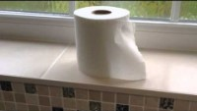
3. Living with a teenager……

Slide 8
3. Living with a teenager……
When they are working, pop in from time-to-time + cup of tea + snack and PRAISE them!
b. Find an activity to share with your child (walking the dog, favourite guilty
pleasure, eg. British Bake Off)
c. Expect grunts and one-word answers
d. Don’t touch their hair!
e. Be firm about mobile phone – they do not need their phone to go to sleep.
Remove it from the bedroom.
f. Computer games – need to finish by 7.30pm. Remove the console.
Agree a set bedtime – 9.30pm – 10pm is late enough for a Year 10 student.
REMEMBER THAT THEY ARE STILL CHILDREN…….

Slide 9

4. Does my attendance matter?​
Attending well – the best attendance you can possibly have.
A student with 80% attendance (1 day off per week) will miss 1 whole year of school – you will not achieve your potential.

Slide 10
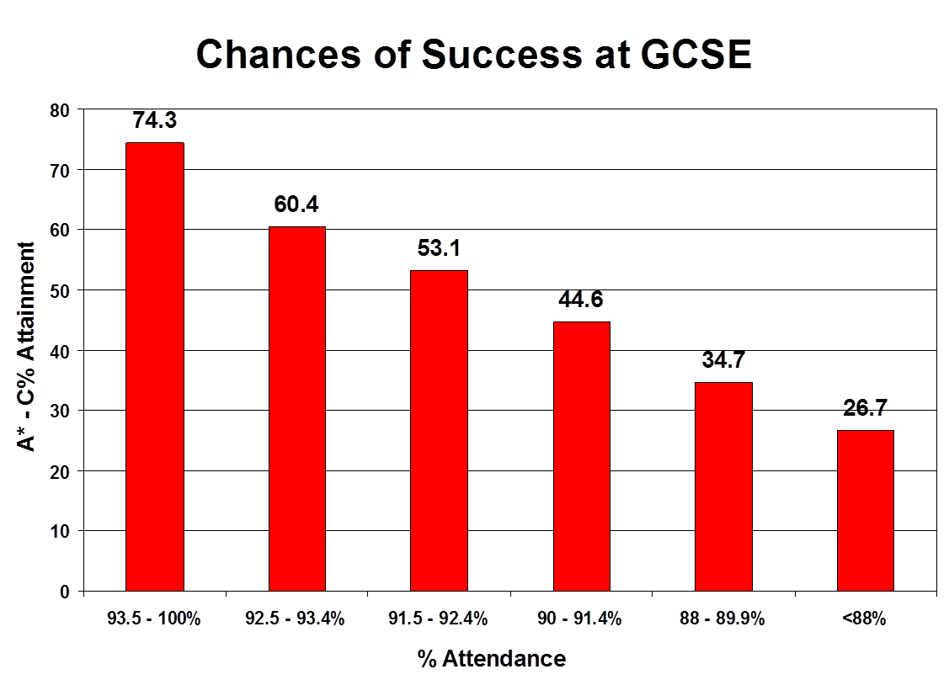
4. Does my attendance matter?

Slide 11
4. Does my attendance matter?
% Attendance | Judgement | Days absent | Impact on your progress
100% | Excellent | 0 days | You are in an excellent position to thrive and achieve well
98% | Very good | 4 days | You are in a strong position to thrive and achieve well
96% | Acceptable | 9 days | You are in a good position to thrive and achieve well but may have missed subject content.
90%-95% | Low attendance and a cause for concern | 14-18 days | You are not in a good position to thrive and achieve well. Relationships could be affected. There will be a significant lack of subject content that will amount to at least one grade lower at GCSE. Your parents/carers may be issued with a Penalty Notice.
90% and below | Extreme cause for concern | 19 days or more | You will struggle to thrive and achieve well. You will find it very difficult to catch up on missed work and are likely to achieve at least 2 grades lower at GCSE. Your parents / carers may be issued with a Penalty Notice.

Slide 12
5. Who to contact?
1. Subject matter?
Contact the class teacher.
2. Pastoral matter?
Contact the pastoral leader: Mr. Michael Mason

Slide 13
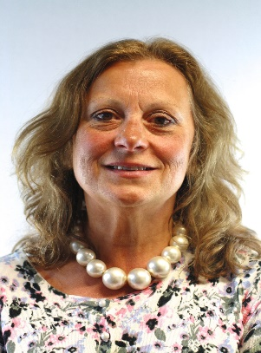
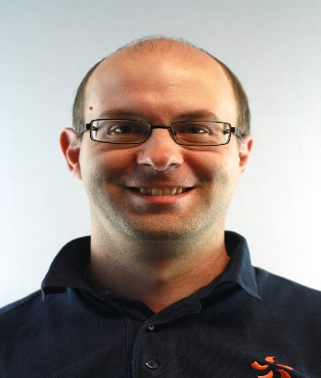
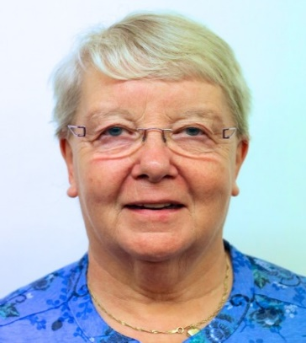
Chair of Governors
Mary Higgins
Vice Chair of Governors
Steven Whitehorn
Safeguarding Governor
Sheila Newman
Community | Performance | Finance
Sheila Newman | Steven Whitehorn | Bob Whittard
Craig Bloxsome | Claire Weaving | Dale Wicks
Debbie Griffin | Amy Fitzgerald-Johnson | Karen Clinton
Stephen Tuffin | Mary Higgins | Jon Haviland
David Lord
Nic Young (Staff) | Stephen Fuller (Staff) | Dani Lee (Staff)
Bryan Gardner (Staff) | Kathryn Rayfield (Staff)

Slide 14
Thank You!

